Slide 1


Slide 2

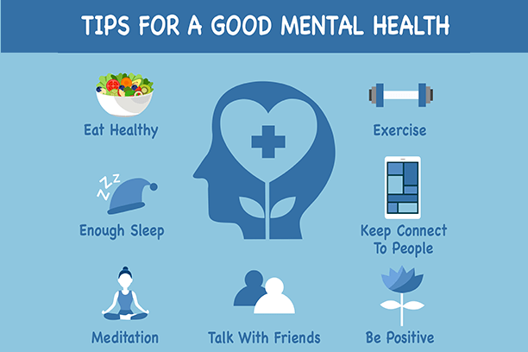
This week, is Children’s mental health week. What does this mean?
Notes:
Discuss that mental health is something that we all have. We all have thoughts and feelings and its important to care for our thoughts and feelings like we care for our friends. There are lots of ways we can care for our mental health like ….. But this week we are focusing on connecting with people.

Slide 3
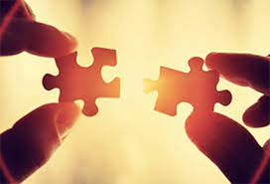
What does connecting with others mean to you?
There are lots of ways we can make meaningful connections with other people. Those connections can have a negative or positive affect on our mental health.
Some ways to connect with others-
Talk, ask questions, listen, share, play, have fun.
Look out for signs when a connection is unhealth and affects your mental health. These connections might make you feel sad or unhappy.

Slide 4


Who have you already connected with today?
How did you connect?
Notes:
Take a piece of string and line it up across the front of the class. Ask a child to hold 1 end. Who have you spoken to today? Bring that child to hold onto the string. This shows a connection. Then ask the new child, who have you played with today? Bring the person up to join the string. Then continue with other questions, pulling up children to show our connections. Who have you listened to today? Who have you laughed with together. These children are all connected to someone else through their shared experiences.

Slide 5

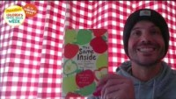
Together by Matt Goodfellow
Watch this video: https://youtu.be/bOsbofgusak.
Poet Matt Goodfellow reads his poem 'Together' as part of Children's Mental Health Week 2023. This poem is taken from the book 'The Same Inside', published by Macmillan.

Slide 6
We are all connected because we come to Holy Trinity each day. You can be the difference that makes those connections positive or negative.
During PSHE this week, you will complete a task about connecting with other people.
On Thursday 9th February, you are all invited to take part in a themed dress up day.
You will now complete a class activity.

